Slide 1

Compiler Construction 編譯系統
陳奇業 成功大學資訊工程系

Slide 2
Definition
A compiler is an executable program that can read a program in one high-level language and translate it into an equivalent executable program in machine language.
program in
high-level
language
Compiler
executable program in machine language
Executable program
in machine language
input
output

Slide 3
Grading
Assignments (40%)
Quizzes (20%)
Mid-term Exam (20%)
Final Exam (20%)

Slide 4
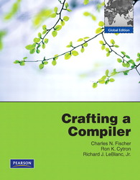
Course Material
Crafting a Compiler, Fischer, Cytron, and LeBlanc, 0138017859

Slide 5
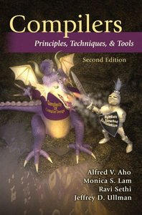
References
Compilers: Principles, Techniques, and Tools, Aho, Lam, Sethi, and Ullman

Slide 6
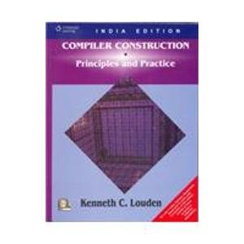
References
Compiler Construction - Principles and Practice, Kenneth C. Louden

Slide 7
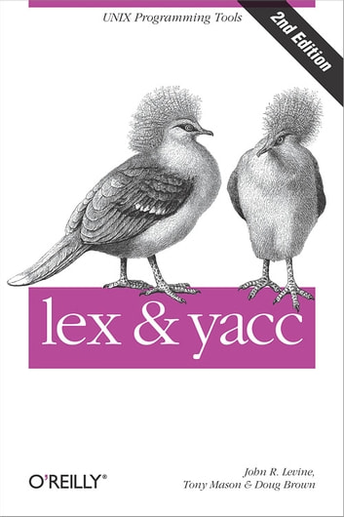
References
Lex & Yacc, Doug Brown, John Levine, and Tony Mason

Slide 8
日期 | 進度說明 Progress Description
2/23 | Introduction and Overview
3/1 | A Simple Compiler
3/8 | Theory and Practice of Scanning
3/15 | Lex (HW #1) and quiz #1
3/22 | Grammars and Parsing
3/29 | Top-Down Parsing I
4/5 | 春假
4/12 | Top-Down Parsing II
4/19 | Midterm
4/26 | Bottom-Up Parsing I
5/3 | Bottom-Up Parsing II
5/10 | Yacc (HW #2) and quiz #2
5/17 | Syntax-Directed Translation
5/24 | Intermediate Representations(HW #3)
5/31 | Code Generation for a Virtual Machine
6/7 | Runtime Support, Target Code Generation
6/14 | Final
6/21 | Project demo (A simple compiler)

Slide 9
Chapter 1
Introduction

Slide 10
Compiler
Source program
Target program

Slide 11
The progression of programming languages:
Machine language c7 06 0000 0002
Assembly language mov x 2
High-level language x = 2
*The first compiler was developed by the team at IBM led by John Backus between 1954 and 1957.

Slide 12
Why do we need to learn compilers?
(1) for new platforms
(2) for new languages - language extensions & improvement - specification languages - 4th generation languages (Ex: Perl, Python, Ruby, SQL, and MatLab)
(3) foundation of parallelizing compilers & related tools
(4) theories learned are applicable to other fields e.g., silicon compiler, prototyping tools, database languages, text formatter, FSM (Finite State Machine) translator, query interpreter, command interpreter, interface programs, etc.
(5) for improving capabilities of existing compiler/interpreter

Slide 13
Silicon compiler
Source language: conventional programming language Variables represents not the location but logical signals (0 or 1) or groups of signals in a switching circuit.
Output : circuit design in an appropriate language

Slide 14
Programs Related to Compilers
source program
Interpreters
Assemblers
Linkers
Loaders
Preprocessors
Editors
Debuggers
Profilers
Project Managers
preprocessor
modified source program
compiler
target assembly program
assembler
relocatable machine code
linker/loader
Library
files
target machine code

Slide 15
Definitions of Languages
Source language
Target language
Implementation language

Slide 16

Translator
A program, written in the implementation language, that takes sentences (strings) in the source language and outputs equivalent sentences (strings) in the target language. e.g. - preprocessor, pretty printer, fortran2c, pascal2c (high to high), assembler (low to lower), disassembler (lower to low), compiler (high to low)

Slide 17
Category of compilers
1. Self-compiling Compiler Source and implementation languages are the same.
2. Self-resident Compiler Implementation and object languages are the same.
3. Cross compiler A compiler that runs on one machine and produces object code for another machine.

Slide 18
Developing the first compiler
Suppose that we have a self-compiling C compiler for Sun Sparc 2. Suppose we also have an inefficient self-resident C compiler for Sun Sparc 2. How can we get an efficient self-resident C compiler for Sun Sparc 2?
C
Sun
C
Sun
C
C
Sun
Sun
dirty
Sun
inefficient
C
Sun
C
Sun
C
C
Sun
Sun
Sun
inefficient
efficient

Slide 19
Porting a compiler for a new machine
Suppose that you have a self-compiling C compiler for Sun Sparc 2. Suppose you also have a self-resident C compiler for IBM AS400. How can we get a self-resident C compiler for Sun Sparc 2?
C
Sun
C
Sun
C
C
As
As
Cross compiler
As
C
Sun
C
C
Sun
C
Sun
Sun
As
Cross compiler

Slide 20
Extending a language and developing its corresponding compiler
Suppose you have both self-compiling and self-resident C compilers for Sun Sparc 2. If you want to extend the C language to become C+ with some new features. How do you get the self-compiling and self-resident C+ compilers for Sun Sparc 2?
C+
Sun
C+
Sun
C
C
Sun
Sun
Sun
C+
Sun
C+
Sun
C+
C+
Sun
Sun
Sun

Slide 21
Improving an existing compiler
Suppose you have a good self-resident C compiler for IBM AS400. Now you want to develop an enhanced version of C compiler with excellent optimizing capabilities for IBM AS400. How do you do it?
C
As
C
As
C
C
As
As
inefficient
As
C
As
C
C
As
C
As
As
efficient
As
inefficient

Slide 22
Interpreter
Def. An interpreter performs the operations implied by the source program.
Source
program
Interpreter
output
input

Slide 23
A hybrid compiler
Source program
Translator
Intermediate program
Virtual
Machine
Output
Input

Slide 24
The Analysis-Synthesis Model of Compilation
There are two parts to compilation: analysis & synthesis.
During analysis, the operations implied by the source program are determined and recorded in a hierarchical structure called a tree.
During synthesis, the operations involved in producing translated code.

Slide 25
The Front-end and Back-end Model of Compilation
Intermediate Code
Source Code
Target Code
Front End
Back End

Slide 26
Compiling Process & Compiler Structure
Source code (Stream of chars)
preprocessor
scanner
parser
semantic analyzer
Code optimizer/intermediate code generator
Advanced code optimizer
code generator
optimizer
Target Code

Slide 27
Compiler Structure (continued)
C
O
M
P
I
L
E
R
Literal Table
Symbol Table
Error Handler

Slide 28

Preprocessor (or Character handler )
throw away the comments
compress multiple blank characters
include files (include nested files)
perform macro expansions (nested macro expansion) - a macro facility is a text replacement capability (two aspects: definition & use). - a macro statement will be expanded into a set of programming language statements or other macro.
compiler option (conditional compilation) (These jobs may be conducted by lexical analyzer.)

Slide 29

Scanner (Lexical Analyzer)
To identify lexical (語彙) structure
Input: a stream of chars;
Output: a stream of tokens.
A scanner may also enter identifiers into the symbol table and enter literals into literal table. (literals include numeric constants such as 3.1415926535 and quoted strings such as “Hello, world!”).

Slide 30
An Example: a[index] = 4 + 2 ;
(1) Output of the Scanner : a ===> identifier [ ===> left bracket index ===> identifier ] ===> right bracket = ===> assignment 4 ===> number + ===> plus sign 2 ===> number ; ===> semicolon

Slide 31
How tokens (string of chars) are formed from underlying character set?
Usually specified (described) by sequence of regular expression.
Lexical structures are analyzed via finite state automata.
But it has the look-ahead requirement. (To recognize a token the scanner may need to look more characters ahead of the token.)

Slide 32
Parser (Syntax Analyzer)
To identify syntax structure
Input: a stream of tokens
Output: On a logical level, some representation of a parse tree.
Determine how do the tokens fit together to make up the various syntax entity of a program. ** Most compilers do not generate a parse tree explicitly but rather go to intermediate code directly as syntax analysis takes place.
Usually specified via context free grammar.

Slide 33
(2) Output of the parser – parse tree (logical level)
expression
expression
=
expression
assign-expression
subscript-expression
expression
[
expression
]
identifier a
identifier index
additive-expression
expression
+
expression
number 4
number 2
structure names
tokens

Slide 34
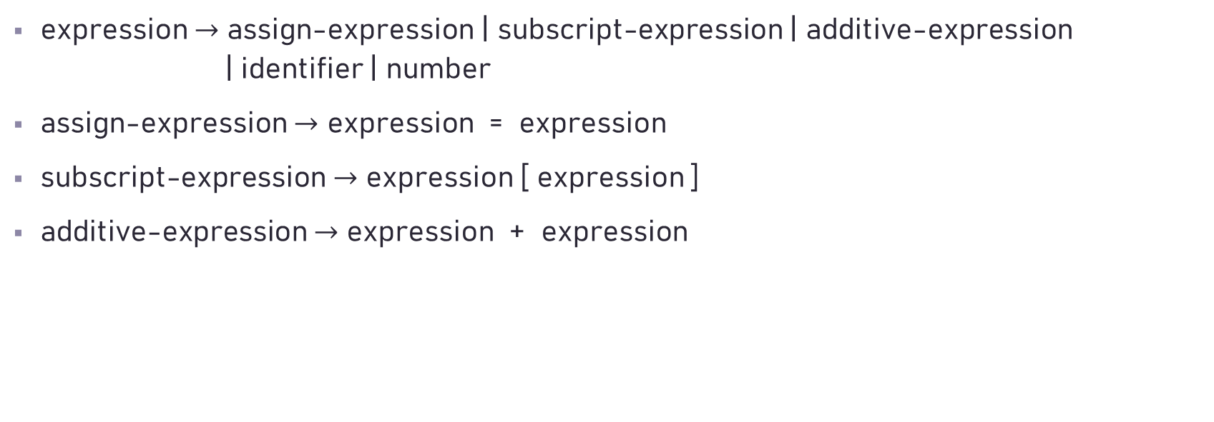
Predefined context-free grammar
expression $→$ assign-expression | subscript-expression | additive-expression | identifier | number
assign-expression $→$ expression = expression
subscript-expression $→$ expression [ expression ]
additive-expression $→$ expression + expression

Slide 35
(2)’ Output of the parser – Abstract Syntax Tree (condensed parse tree)
= assign-expression
[] subscript-expression
+ additive-expression
number 4
identifier a
identifier index
number 2

Slide 36

Semantic Analyzer
Semantic Structure
What is the program supposed to do?
Semantics analysis can be done during syntax analysis phase or intermediate code generator phase or the final code generator.
typical static semantic features include declarations and type checking.
information (attributes) gathered can be either added to the tree as annotations or entered into the symbol table.

Slide 37
(3) Output of the semantic analyzer – annotated AST
assign-expression
subscript-expression integer
additive-expression integer
identifier a
identifier index
number 4
number 2
array of integer with subscripts from a range
integer
integer
integer

Slide 38
(3) Output of the semantic analyzer (cont’d)
finds the consistence of data type among ‘a’, ‘index’, and 2 + 4, or
declares a type dismatch error if not.

Slide 39

The time ratio for scanning, parsing, and semantic processing is 30:25:45.

Slide 40

Source Code Optimizer

Slide 41
(4)’ Output of the Source Code Optimizer
assign-expression
subscript-expression integer
number 6
identifier a
identifier index
integer
array of integer with subscripts from a range
integer

Slide 42

Intermediate Code Generator
Transform the parse tree (logical level) into an intermediate language representation, e.g., three address code: A = B op C ( op is a binary operator)
Difference between intermediate code and assembly code
Specify the registers to be used for each operation in assembly code
Actually intermediate code can be represented as any internal representation such as the syntax tree.

Slide 43
(4) Output of the intermediate code generator
intermediate code (three address code, two address code, P-code, etc.)
Three address code
temp = 6 a [ index ] = 6
a [ index ] = temp
Quadruple: (in implementation)
12
15
27
#6
15
a
operator
location1
location2
location3
.
.
=
temp
6
8
33
#6
27
index
.
[]=
a
index
temp
12
15
27
33
.
33
temp
(symbol table)
( logical )
( reality )

Slide 44
Advanced Code Optimizer
Detection of undefined variables
Detection of loop invariant computation
Constant folding
Removal of induction variables
Elimination of common expression

Slide 45
Induction Variable Elimination
When there are two or more induction variables in a loop we have opportunity to get rid of all but one.
….. …..
I = 1 T = 0
Repeat Repeat
T = 4 * I ===> T = T + 4
X = Y [T] X = Y [T]
Prod = Prod + X Prod = Prod + X
I = I + 1 Until T > 76
Until I > 20
* Suppose I is not needed after the loop terminates

Slide 46
Elimination of common expression
A = B + C + D
E = B + C + F
might be
T = B + C
A = T + D
E = T + F

Slide 47
Code Generator

Slide 48

(5) Output of the code generator
Mov R0, index // value of index -> R0
Mul R0, 2 // double value in R0
Mov R1, &a // address of a -> R1
Add R1, R0 // add R0 to R1
Mov *R1, 6 // constant 6 -> address in R1

Slide 49
(Machine-dependent) Peephole Optimizer
A simple but effective technique for locally improving the target code.
Examine a short sequence of target instruction (called peephole) and replacing these instruction by a shorter or faster sequence whenever possible. e.g. redundant instruction elimination flow-of-control optimization algebraic simplification use of machine idioms

Slide 50
(6) Output of the peephole optimizer
Mov R0, index // value of index -> R0
Shl R0 // double value in R0
Mov &a[R0], 6 // constant 6 -> address a + R0

Slide 51
Error Handling (Detection & Reporting)
An important function of the compiler.
Errors can be encountered by all of the phases of a compiler.
The error messages should be reported to allow the programmer to determine where the errors have occurred.
Once the error has been noted the compiler must modify the input to allow the latter phases can continue processing.

Slide 52
Phase | Example
Lexical Analyzer | A token is misspelled.
Syntax Analyzer | A syntax entity is unable to be inferred.
Semantic analyzer/Intermediate Code Generator | An operator whose operands have incompatible types.
Code Optimizer | Certain statements can never be reached.
Code Generator | A compiler-created constant is too large to fit in a word of the target machine
Symbol Table Management | An identifier that has been multiply declared with contradictory attribute.

Slide 53
Major Data Structures in a Compiler
Token => a value
The Syntax Tree => pointer-based structure
The Symbol Table => hash table/an array of struct/…
The Literal Table => an array of struct
Intermediate Code => Quadruple (an array of struct)
Temporary Files

Slide 54
